Slide 1
ENTREPRENEURSHIP
POSITIONING & GROWTH STRATEGY

Slide 2
The Nature of Planning in Emerging Firms
Most entrepreneurs’ planning for their ventures is informal and unsystematic.
The need for formal, systematic planning arises when:
  The firm is expanding with constantly increasing personnel size and market operations
  A high degree of uncertainty exists
  There is strong competition
  There is a lack of adequate experience, either technological or business

Slide 3
Strategic Planning
Strategic Planning
  The formulation of long-range plans for the effective management of environmental opportunities and threats in light of a venture’s strengths and weaknesses.
  Includes:
    Defining the venture’s mission
    Specifying achievable objectives
    Developing strategies
    Setting policy guidelines

Slide 4
Strategic Planning (cont’d)
Basic Steps in Strategic Planning:
  Examine the internal and external environments of the venture (strengths, weaknesses, opportunities, threats).
  Formulate the venture’s long-range and short-range strategies (mission, objectives, strategies, policies).
  Implement the strategic plan (programs, budgets, procedures).
  Evaluate the performance of the strategy.
  Take follow-up action through continuous feedback.

Slide 5
Key Dimensions Influencing a Firm’s Strategic Planning Activities
Demand on strategic managers’ time
Decision-making speed
Problems of internal politics
Environmental uncertainty
The entrepreneur’s vision
  Step 1: Commitment to an open planning process.
  Step 2: Accountability to a corporate conscience.
  Step 3: Establishment of a pattern of subordinate
  participation in the development of the
  strategic plan.

Slide 6
The Lack of Strategic Planning
Reasons for the Lack of Strategic Planning
  Time scarcity
  Lack of knowledge
  Lack of expertise/skills
  Lack of trust and openness
  Perception of high cost

Slide 7
The Value of Strategic Planning
Findings of Strategic Planning Studies
  Strategic planning is of value to a venture and that planning influences a venture’s survival.
Benefits of Long-Range Planning
  Cost savings
  More efficient resource allocation
  Improved competitive position
  More timely information
  More accurate forecasts
  Reduced feelings of uncertainty
  Faster decision making
  Fewer cash-flow problems

Slide 8
Strategic Planning Levels (cont’d)
Strategic Planning Categories (Rue and Ibrahim)
  Category I: No written plan
  Category II: Moderately sophisticated planning
  Category III: Sophisticated planning
    Results: More than 88% of firms with Category II or III planning performed at or above the industry average compared with only 40% of firms with Category I planning.
All research indicates:
  Firms that engage in strategic planning are more effective than those that do not.
  The planning process, rather than merely the plans, is a key to successful performance.

Slide 9
Fatal Visions in Strategic Planning
Fatal mistakes that entrepreneurs fall prey to in their attempt to implement a strategy:
  Fatal Vision #1: Misunderstanding industry
  attractiveness
  Fatal Vision #2: No real competitive advantage
  Fatal Vision #3: Pursuing an unattainable competitive
  position
  Fatal Vision #4: Compromising strategy for growth
  Fatal Vision #5: Failure to explicitly communicate the venture’s strategy to employees

Slide 10
Strategic Positioning:
The Entrepreneurial Edge
Strategic Positions
  Are often not obvious, and finding them requires creativity and insight.
  Are unique positions that have been available but simply overlooked by established competitors.
  Can help entrepreneurial ventures prosper by occupying a position that a competitor once held but has ceded through years of imitation and straddling.

Slide 11

Strategic Approaches: Position, Leverage, Opportunities
 | Position | Leverage | Opportunities
Strategic Logic | Establish position | Leverage resources | Pursue opportunities
Strategic Steps | Identify an attractive market Locate a defensible position Fortify and defend | Establish a vision Build resources Leverage across markets | Jump into the confusion Keep moving Seize opportunities Finish strong
Strategic Question | Where should we be? | What should we be? | How should we proceed?
Source Of Advantage | Unique, valuable position with tightly integrated activity system | Unique, valuable, inimitable resources | Key processes and unique simple rules
Works Best In | Slowly changing, well-structured markets | Moderately changing, well-structured markets | Rapidly changing, ambiguous markets
Duration Of Advantage | Sustained | Sustained | Unpredictable
Risk | It will be too difficult to alter position as conditions change | Company will be too slow to build new resources as conditions change | Managers will be too tentative in executing on promising opportunities
Performance Goal | Profitability | Long-term dominance | Growth

Slide 12
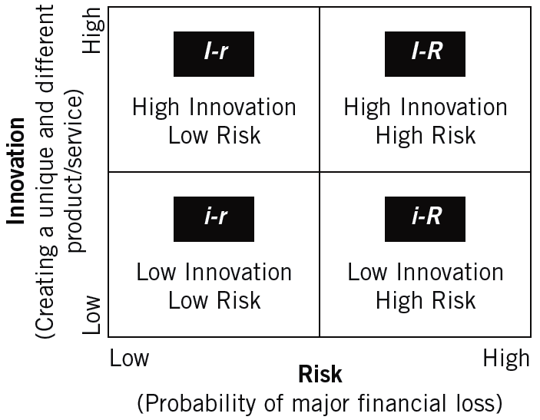
The Entrepreneurial Strategy Matrix: Independent Variables

Slide 13
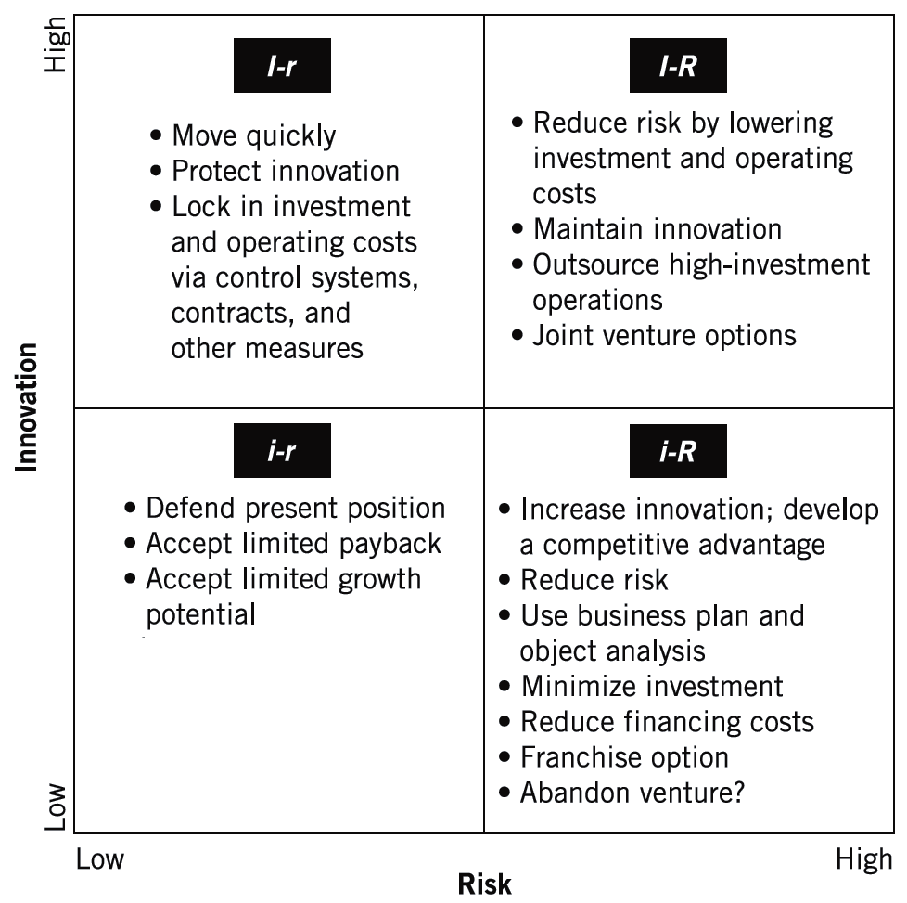
The Entrepreneurial Strategy Matrix: Appropriate Strategies

Slide 14
Venture Development Stages
Life-Cycle Stages of an Enterprise (Chandler)
  Initial expansion and accumulation of resources
  Rationalization of the use of resources
  Expansion into new markets to assure the continued use of resources
  Development of new structures to ensure continuing mobilization of resources

Slide 15
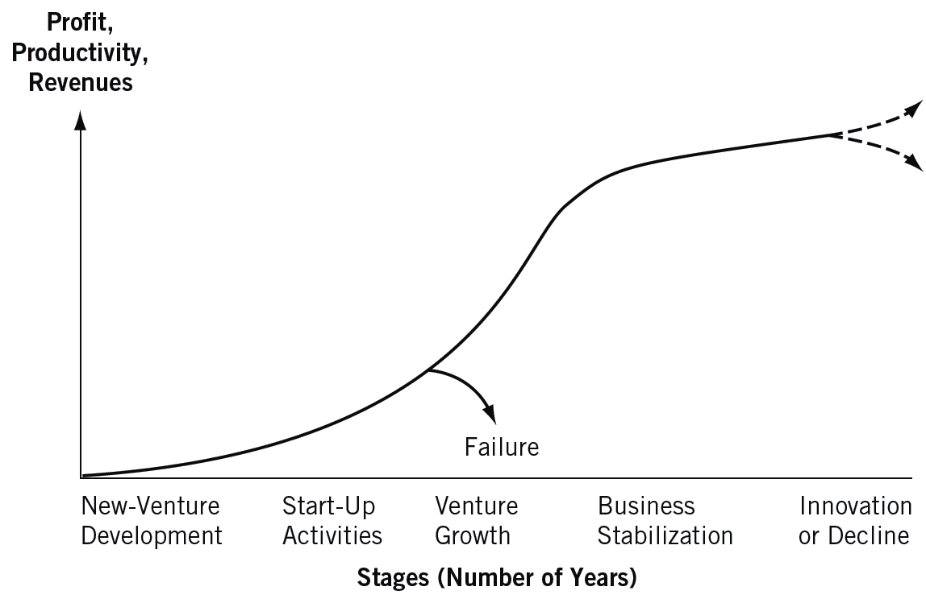
A Venture’s Typical Life Cycle

Slide 16
The Entrepreneurial Company in the Twenty-First Century
Major Challenges:
  Building dynamic capabilities that are differentiated from those of emerging competitors
  Internal—utilization of the creativity and knowledge from employees
  External—the search for external competencies to complement the firm’s existing capabilities.

Slide 17
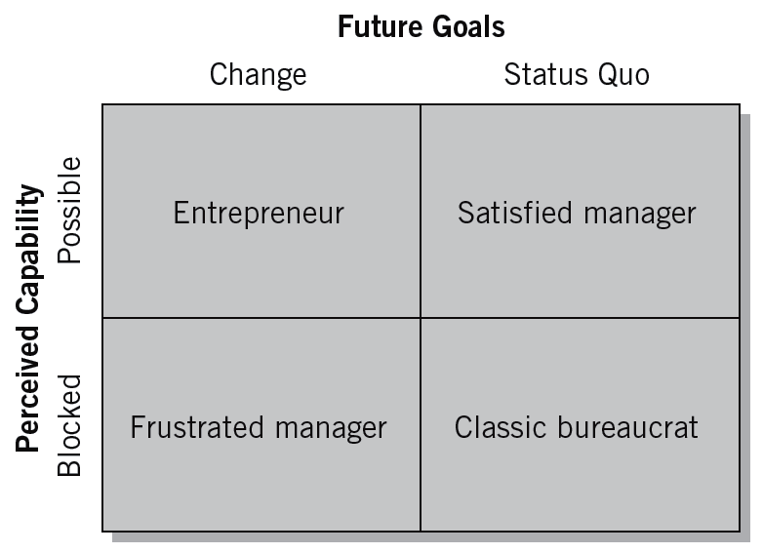
The Entrepreneurial Mindset

Slide 18
The Managerial versus the Entrepreneurial Mind-Set
 | Managerial Mind-Set | Entrepreneurial Mind-Set
Decision-making assumptions | The past is the best predictor of the future. Most business decisions can be quantified. | A new idea or an insight from a unique experience is likely to provide the best estimate of emerging trends.
Values | The best decisions are those based on quantitative analyses. Rigorous analyses are highly valued for making critical decisions. | New insights and real-world experiences are more highly valued than results based on historical data.
Beliefs | Law of large numbers: Chaos and uncertainty can be resolved by systematically analyzing the right data. | Law of small numbers: A single incident or several isolated incidents quickly become pivotal for making decisions regarding future trends.
Approach to problems | Problems represent an unfortunate turn of events that threaten financial projections. Problems must be resolved with substantiated analyses. | Problems represent an opportunity to detect emerging changes and possibly new business opportunities.

Slide 19
Building the Adaptive Firm
An Adaptive Firm
  One that Increases opportunity for its employees, initiates change, and instills a desire to be innovative.
How to remain adaptive and innovative:
  Share the entrepreneur’s vision
  Increase the perception of opportunity
  Institutionalize change as the venture’s goal
  Instill the desire to be innovative:
    A reward system
    An environment that allows for failure
    Flexible operations
    The development of venture teams

Slide 20
The Transition from an Entrepreneurial Style to a Managerial Approach
Impediments to Transition:
  A highly centralized decision-making system
  An overdependence on one or two key individuals,
  An inadequate repertoire of managerial skills and training
  A paternalistic atmosphere

Slide 21
The Entrepreneurial Culture versus the Administrative Culture
 | Entrepreneurial Focus |  | Administrative Focus
 | Characteristics | Pressures | Characteristics | Pressures
Strategic Orientation | Driven by perception of opportunity | Diminishing opportunities Rapidly changing technology, consumer economics, social values, and political rules | Planning systems and cycles | Social contracts Performance measurement criteria
Commitment to Seize Opportunities | Revolutionary, with short duration | Action orientation Narrow decision windows Acceptance of reasonable risks Few decision constituencies | Evolutionary, with long duration | Acknowledgement of multiple constituencies Negotiation about strategic course Risk reduction Coordination with existing resource base
Commitment of Resources | Many stages, with minimal exposure at each stage | Lack of predictable resource needs Lack of control over the environment Social demands for appropriate use of resources Foreign competition Demands for more efficient use | A single stage, with complete commitment out of decision | Need to reduce risk Incentive compensation Turnover in managers Capital budgeting systems Formal planning systems
Control of Resources | Episodic use or rent of required resources | Increased resource specialization Long resource life compared with need Risk of obsolescence Risk inherent in the identified opportunity Inflexibility of permanent commitment to resources | Ownership or employment of required resources | Power, status, and financial rewards Coordination of activity Efficiency measures Inertia and cost of change Industry structures
Management Structure | Flat, with multiple informal networks | Coordination of key noncontrolled resources Challenge to hierarchy Employees’ desire for independence | Hierarchy | Need for clearly defined authority and responsibility Organizational culture Reward systems Management theory

Slide 22
Balancing the Focus—Entrepreneurial versus Manager (Stevenson and Gumpert)
The Entrepreneur’s
Point of View
  Where is the opportunity?
  How do I capitalize on it?
  What resources do I need?
  How do I gain control over them?
  What structure is best?
The Administrative
Point of View
  What resources do I control?
  What structure determines our organization’s relationship to its market?
  How can I minimize the impact of others on my ability to perform?
  What opportunity is appropriate?

Slide 23
Understanding the Growth Stage
Key Factors During the Growth Stage
  Control
    Does the control system imply trust?
    Does the resource allocation system imply trust?
    Is it easier to ask permission than to ask forgiveness?
  Responsibility
    Creating a sense of responsibility that establishes flexibility, innovation, and a supportive environment.
  Tolerance of failure
    Moral failure
    Personal failure
    Uncontrollable failure
  Change

Slide 24
Understanding the Growth Stage (cont’d)
Managing Paradox and Contradiction
  Bureaucratization versus decentralization
  Environment versus strategy
  Strategic emphases: Quality versus cost versus innovation

Slide 25
Confronting the Growth Wall
Successful growth-oriented firms have exhibited consistent themes:
  The entrepreneur is able to envision and anticipate the firm as a larger entity.
  The team needed for tomorrow is hired and developed today.
  The original core vision of the firm is constantly and zealously reinforced.
  “Big-company” processes are introduced gradually as supplements to, rather than replacements for, existing approaches.
  Hierarchy is minimized.
  Employees hold a financial stake in the firm.

Slide 26
Unique Managerial Concerns of Growing Ventures
Distinction
of Small Size
One-Person-Band
Syndrome
Continuous
Learning
Growing Venture
Time
Management
Community
Pressures

Slide 27
The International Environment:
Global Opportunities
Global Entrepreneurs
  Rely on global networks for resources, design, and distribution.
  Are adept at recognizing opportunities that require agility, certainty, and ingenuity with a global perspective.
  Must be global thinkers in order to design and adopt strategies for different countries.

Slide 28
Achieving Entrepreneurial Leadership in the New Millennium
Entrepreneurial Leadership
  Arises when an entrepreneur attempts to manage the fast-paced, growth oriented company.
Components of Entrepreneurial Leadership
  Determining the firm’s purpose or vision.
  Exploiting and maintaining the core competencies.
  Developing human capital.
  Sustaining an effective organizational culture.
  Emphasizing ethical practices.
  Establishing balanced organizational controls.

Slide 29
Strategic, Visionary, and Managerial Leadership
STRATEGIC LEADERS
synergistic combination of managerial and visionary leadership
emphasis on ethical behavior and value-based decisions
oversee operating (day-to-day) and strategic (long-term) responsibilities
formulate and implement strategies for immediate impact and preservation of long-term goals to enhance organizational survival, growth, and long-term viability
have strong, positive expectations of the performance they expect from their superiors, peers, subordinates, and themselves
use strategic controls and financial controls, with emphasis on strategic controls
use, and interchange, tacit and explicit knowledge on individual and organizational levels
use linear and nonlinear thinking patterns
believe in strategic choice, that is, their choices make a difference in their organizations and environment

Slide 30
Strategic, Visionary, and Managerial Leadership
Visionary Leaders | Managerial Leaders
are proactive, shape ideas, change the way people think about what is desirable, possible, and necessary | are reactive; adopt passive attitudes toward goals; goals arise out of necessities, not desires and dreams; goals based on past
work to develop choices, fresh approaches to long standing problems; work from high-risk positions | view work as an enabling process involving some combination of ideas and people interacting to establish strategies
are concerned with ideas; relate to people in intuitive and empathetic ways | relate to people according to their roles in the decision-making process
feel separate from their environment; work in, but do not belong to, organizations; sense of who they are does not depend on work | see themselves as conservators and regulators of existing order; sense of who they are depends on their role in organization
influence attitudes and opinions of others within the organization | influence actions and decisions of those with whom they work
concerned with insuring future of organization, especially through development and management of people | involved in situations and contexts characteristic of day-to-day activities
more embedded in complexity, ambiguity, and information overload; engage in multifunctional, integrative tasks | concerned with, and more comfortable in, functional areas of responsibilities
know less than their functional area experts | expert in their functional area
more likely to make decisions based on values | less likely to make value-based decisions
more willing to invest in innovation, human capital, and creating and maintaining an effective culture to ensure long-term viability | engage in, and support, short-term, least-cost behavior to enhance financial performance figures
focus on tacit knowledge and develop strategies as communal forms of tacit knowledge that promote enactment of a vision | focus on managing the exchange and combination of explicit knowledge and ensuring compliance to standard operating procedures
utilize nonlinear thinking | utilize linear thinking
believe in strategic choice, that is, their choices make a difference in their organizations and environment | believe in determinism, that is, the choices they make are determined by their internal and external environments

Slide 31
Entrepreneurial Strategy and Competitive Dynamics
8
McGraw-Hill/Irwin
Strategic Management: Text and Cases, 4e
Copyright © 2008 The McGraw-Hill Companies, Inc. All rights reserved.

Slide 32
Recognizing Entrepreneurial Opportunities
Entrepreneurship – new value creation
New value can be created in:
  Start-up ventures
  Major corporations
  Family-owned businesses
  Non-profit organizations
  Established institutions

Slide 33
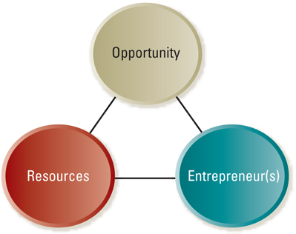
Opportunity Analysis Framework

Slide 34
Entrepreneurial Opportunities
Opportunities come from many sources
  Start-ups
    Current or past work experiences
    Hobbies that grow into businesses or lead to inventions
    Suggestions by friends or family
    Chance events
    Change

Slide 35
Entrepreneurial Opportunities
Opportunities come from many sources
  Established firms
    Needs of existing customers
    Suggestions by suppliers
    Technological developments that lead to new advances
    Change

Slide 36
Entrepreneurial Opportunities
Discovery phase
  Period when you first become aware of a new business concept
  May be spontaneous and unexpected
  May occur as the result of deliberate search for
    New venture projects
    Creative solutions to business problems

Slide 37
Opportunity Recognition Process
Opportunity evaluation phase
  Evaluating an opportunity (Can it be developed into a full-fledged new venture?)
    Talk to potential target customers
    Discuss it with production or logistics managers
    Conduct feasibility analysis
      Market potential
      Product concept testing
      Focus groups
      Trial runs with end users

Slide 38
Characteristics of Good Opportunities
Good Business Opportunity
Attractive
Value creating
Achievable
Durable
Before launching opportunity as a business
  Consider the resources available to undertake it
  Consider the characteristics of the entrepreneur pursuing it

Slide 39
Entrepreneurial Resources
Major challenge for entrepreneurial firm is lack of resources
  Money
  Human capital
  Social capital

Slide 40
Entrepreneurial Resources
Financial Resources
  Early-stage financing
    Personal savings, family, and friends
    Bank financing, public financing, venture capital
      Debt
      Equity

Slide 41
Entrepreneurial Resources
Financial resources (Going Concern)
  Later-stage financing
    Angel investors
    Venture capital
      Equity financing
    Commercial banks

Slide 42
Entrepreneurial Resources
Human capital
Social capital
Government resources
  Small Business Administration
  Government contracting
  State and local governments

Slide 43
Entrepreneurial Leadership
Launching a new venture requires a special kind of leadership
  Courage
  Belief in one’s convictions
  Energy to work hard
Three characteristics
  Vision
  Dedication and drive
  Commitment to excellence

Slide 44
Entrepreneurial Leadership
Vision may be entrepreneur’s most important asset
  Ability to envision realities that do not yet exist
  Exercise a kind of transformational leadership
  Able to share with others

Slide 45
Entrepreneurial Leadership
Dedication and drive are reflected in hard work
  Patience
  Stamina
  Willingness to work long hours
  Internal motivation
  Intellectual commitment to the enterprise
  Strong enthusiasm for work and life

Slide 46
Entrepreneurial Leadership
To achieve excellence, venture founders and small business owners must
  Understand the customer
  Provide quality products and services
  Pay attention to details
  Continuously learn
  Surround themselves with good people

Slide 47
Example
Here are 10 management lessons from a young entrepreneur, Scott Smigler, the founder of Exclusive Concepts Inc.:
It’s all about perseverance
Understand the value of mentorship and teamwork
Stick to your niche
Stay on top of news that affects your clients
Communication is key
Capitalization is crucial
Communication unwavering honesty and integrity
Stay on top of the curve
Take ownership in your clients’ success
Never stop marketing

Slide 48
Entrepreneurial Strategy
Best strategy for the enterprise will be determined to some extent by
  A viable opportunity, resources, and entrepreneur(s)
  Other conditions in the business environment
Can use various tools and techniques to determine strategic choices
  Five Forces analysis
  Value chain analysis

Slide 49
Entry Strategies
Getting a foothold in the market
  Pioneering new entry
    Creating new ways to solve old problems
    Meeting customer’s needs in a unique new way
  Imitative new entry
    Strong marketing orientation
    Introduce same basic product or service in another segment of the market

Slide 50
Entry Strategies
Getting a foothold in the market
  Adaptive new entry
    Offer product or service that is “somewhat new and different”
    Aware of marketplace conditions and conceive entry strategies to capitalized on current trends

Slide 51
Generic Strategies
How new ventures can achieve competitive advantages
  Overall cost leadership
    Simple organizational structures
    More quickly upgrade technology and integrate feedback from the marketplace
    Make timely decisions that affect cost
  Differentiation
    Use new technology
    Deploy resources in a radical new way
  Focus
    Niche strategies fit the small business mold

Slide 52
Combination Strategies
A key issue is the scope of a small firm’s strategic efforts relative to those of its competitors
  Pursue combination strategies
    Combine best features of low-cost, differentiation, and focus strategies
    Flexibility and quick decision-making ability of a small firm not laden with layers of bureaucracy

Slide 53
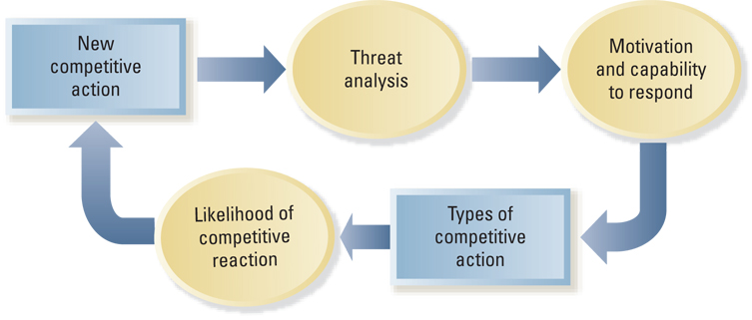
Model of Competitive Dynamics

Slide 54
Five “Hardball” Strategies
Devastate rivals’ profit sanctuaries
Plagiarize with pride
Deceive the competition
Unleash massive and overwhelming force
Raise competitors’ costs

Slide 55
Strategic and Tactical
Competitive Actions
Actions
Entering new markets
New product introductions
Changing production capacity
Mergers/Alliances
Price cutting (or increases)
Product/service enhancements
Increased marketing efforts
New distribution channels
Strategic Actions
Tactical Actions

Slide 56
Likelihood of Competitive Reaction
How a competitor is likely to respond will depend on three factors
  Market dependence
  Competitor’s resources
  The reputation of the firm that initiates the action (actor’s reputation)

Slide 57
Why do Businesses Fail?

Slide 58

Why Do Businesses Fail?
Reasons for failure are usually more obvious than reasons for business success…
a) Lack of skill / knowledge
b) Expanding too quickly
c) Lack of capital
d) Inability to stay competitive

Slide 59
Lack of Skill or Knowledge
High school and post secondary business courses
Experience in business
Business failure often results from:
1) Poor marketing
2) Poor accounting
Notes:
Business courses in high school and College/University as well as experience working in business all provide some of the skills necessary to run a business.
It is unrealistic to assume that without business skills (education and experience) you can operate a successful business. It would be like asking a person who has never learned to be an electrician to wire your house. Or asking someone’s medical opinion who has never been to medical school.
Poor marketing is when you cannot get your product out to the consumers
Poor accounting is when you are spending to much money on inventory and too much money on expenses

Slide 60
Marketing experts:
- good at promotional ideas
- creative advertising
- colorful & eye catching displays
- predict demand
- spot trends & fads
- appreciation for product design/package graphic
- good customer service
Notes:
Good marketers know how to reach the customers and they know how to talk to them

Slide 61
Accountants
- set budgets
- Buying Quotas: limits on the amount of money a business should spend on inventory
- negotiate terms
- pay invoices on time
- keep financial records
- make sure a business is profitable
Notes:
The major goal of an accountant is to make sure a business is profitable.
A great example of exceptional marketing but poor accounting is a restaurant owner spending so much money on the décor of the restaurant, and even though the restaurant is beautiful, cots were so high that the restaurant could not make a profit and failed after its first year.
An example of a restaurant with a balance of marketing and accounting is Cactus Club Restaurants, they just started putting a lot more money into the décor of their restaurant, they also hired a celebrity chef to run the culinary aspect of the business but this only happened in the last 4 years but Cactus Restaurants have been open for years.

Slide 62
Expanding too Quickly
Expansion, developing new products, franchise or acquire others businesses
Decisions need to be based on research
Businesses that become successful so fast may try to grow too quickly without analyzing expansion plans
Forgetting your origins can cause businesses financial difficulty
Some businesses are so large that change happens very slowly
Notes:
Many successful businesses decide to expand, develop new products or distribution channels, franchise, or aquire other businesses. If these decisions are based on thorough research and are financially responsible, they will often make a business more profitable by opening up to new markets. However, some businesses become so successful so fast that they try to grow too quickly without analyzing their expansion plans. For example, take a business who has a single retail location because the store was very successful the owners thought to expand to a number of different locations and cities because of the quick expansion the concept of the store changed and was not as popular as it once was. Even though money was coming in, it was not enough to pay of the costs of expansion and the company went bankrupt.

Slide 63
Lack of Capital
Running out of money is often a result of failure to budget properly
It is recommended that you have one year of operating expenses in reserve when going into business
Initial capital from → personal savings, bank loans, investors, partners, friends and family.
If a business is profitable revenue from sales will eventually cover the operating costs.
Notes:
Sometimes businesses have the ability to be successful but owners do not understand the importance of being properly financed. If a business is under-financed and it does not have enough money to carry through the start-up, the business will fail even if it has the potential to be successful.

